Slide 1
Chapter 8
Case Study 2

Slide 2
Clustering individuals as per their demographics
In this case study, we will use clustering methods to identify different types of investors.

Slide 3
Content
1. Problem Definition
2. Getting Started - Load Libraries and Dataset
2.1. Load Libraries
2.2. Load Dataset
3. Exploratory Data Analysis
3.1. Descriptive Statistics
3.2. Data Visualisation
4. Data Preparation
4.1. Data Cleaning
4.2. Data Transformation

Slide 4
Content
5. Evaluate Algorithms and Models
5.1. k-Means Clustering
5.1.1. Finding optimal number of clusters
5.1.2. Clustering and Visualisation
5.2. Affinity Propagation Clustering
5.3. Cluster Evaluation
6. Cluster Intuition

Slide 5
1. Problem Definition

Slide 6
1. Problem Definition
The goal of this case study is to build a machine learning model to cluster individuals/investors based on the parameters related to the ability and willingness to take risk. We will focus on using common demographic and financial characteristics to accomplish this.
For this case study the data used is from survey of Consumer Finances which is conducted by the Federal Reserve Board.

Slide 7
2. Getting Started - Loading the data and python packages

Slide 8
2.1. Loading the python packages
# Load libraries
import numpy as np
import pandas as pd
import matplotlib.pyplot as plt
from pandas import read_csv, set_option
from pandas.plotting import scatter_matrix
import seaborn as sns
from sklearn.preprocessing import StandardScaler
import datetime
from tabulate import tabulate

Slide 9
2.1. Loading the python packages
#Import Model Packages
from sklearn.cluster import KMeans, AgglomerativeClustering, \
AffinityPropagation
from sklearn.metrics import adjusted_mutual_info_score
from sklearn import cluster, covariance, manifold
#Other Helper Packages and functions
import matplotlib.ticker as ticker
from itertools import cycle
# For printing tables
def pretty_print_df(df):
print(tabulate(df, headers='keys', tablefmt='psql', floatfmt='.3f'))

Slide 10
2.2. Loading the Data
The dataset is same as the dataset used, which is further processed to give the following attributes for different investors for the year 2007.
# load dataset
dataset = pd.read_excel('ProcessedData.xlsx’)
# Disable the warnings
import warnings
warnings.filterwarnings('ignore')

Slide 11
3. Exploratory Data Analysis

Slide 12
3.1. Descriptive Statistics
# Print the dataset shape
print(f'Dataset shape: {dataset.shape}')
Sample output:
Dataset shape: (3866, 13)

Slide 13
3.1. Descriptive Statistics
# peek at data
# set_option('display.width', 100)
pretty_print_df(dataset.head(5))
Sample output:
+----+-------+-------+--------+-----------+--------+----------+---------+--------+-----------+----------+------------+---------+---------+
| | ID | AGE | EDUC | MARRIED | KIDS | LIFECL | OCCAT | RISK | HHOUSES | WSAVED | SPENDMOR | NWCAT | INCCL |
|----+-------+-------+--------+-----------+--------+----------+---------+--------+-----------+----------+------------+---------+---------|
| 0 | 1.000 | 3.000 | 2.000 | 1.000 | 0.000 | 2.000 | 1.000 | 3.000 | 1.000 | 1.000 | 5.000 | 3.000 | 4.000 |
| 1 | 2.000 | 4.000 | 4.000 | 1.000 | 2.000 | 5.000 | 2.000 | 3.000 | 0.000 | 2.000 | 5.000 | 5.000 | 5.000 |
| 2 | 3.000 | 3.000 | 1.000 | 1.000 | 2.000 | 3.000 | 2.000 | 2.000 | 1.000 | 2.000 | 4.000 | 4.000 | 4.000 |
| 3 | 4.000 | 3.000 | 1.000 | 1.000 | 2.000 | 3.000 | 2.000 | 2.000 | 1.000 | 2.000 | 4.000 | 3.000 | 4.000 |
| 4 | 5.000 | 4.000 | 3.000 | 1.000 | 1.000 | 5.000 | 1.000 | 2.000 | 1.000 | 3.000 | 3.000 | 5.000 | 5.000 |
+----+-------+-------+--------+-----------+--------+----------+---------+--------+-----------+----------+------------+---------+---------+

Slide 14
3.1. Descriptive Statistics
# describe data
pretty_print_df(dataset.describe())
Sample output:
+-------+----------+----------+----------+-----------+----------+----------+----------+----------+-----------+----------+------------+----------+----------+
| | ID | AGE | EDUC | MARRIED | KIDS | LIFECL | OCCAT | RISK | HHOUSES | WSAVED | SPENDMOR | NWCAT | INCCL |
|-------+----------+----------+----------+-----------+----------+----------+----------+----------+-----------+----------+------------+----------+----------|
| count | 3866.000 | 3866.000 | 3866.000 | 3866.000 | 3866.000 | 3866.000 | 3866.000 | 3866.000 | 3866.000 | 3866.000 | 3866.000 | 3866.000 | 3866.000 |
| mean | 1933.500 | 3.107 | 2.906 | 1.353 | 0.938 | 3.697 | 1.742 | 3.043 | 0.717 | 2.446 | 3.561 | 2.976 | 3.671 |
| std | 1116.162 | 1.513 | 1.066 | 0.478 | 1.249 | 1.618 | 0.934 | 0.879 | 0.451 | 0.743 | 1.304 | 1.463 | 1.184 |
| min | 1.000 | 1.000 | 1.000 | 1.000 | 0.000 | 1.000 | 1.000 | 1.000 | 0.000 | 1.000 | 1.000 | 1.000 | 1.000 |
| 25% | 967.250 | 2.000 | 2.000 | 1.000 | 0.000 | 3.000 | 1.000 | 2.000 | 0.000 | 2.000 | 2.000 | 2.000 | 3.000 |
| 50% | 1933.500 | 3.000 | 3.000 | 1.000 | 0.000 | 3.000 | 1.000 | 3.000 | 1.000 | 3.000 | 4.000 | 3.000 | 4.000 |
| 75% | 2899.750 | 4.000 | 4.000 | 2.000 | 2.000 | 5.000 | 3.000 | 4.000 | 1.000 | 3.000 | 5.000 | 4.000 | 5.000 |
| max | 3866.000 | 6.000 | 4.000 | 2.000 | 8.000 | 6.000 | 4.000 | 4.000 | 1.000 | 3.000 | 5.000 | 5.000 | 5.000 |
+-------+----------+----------+----------+-----------+----------+----------+----------+----------+-----------+----------+------------+----------+----------+

Slide 15
3.2. Data Visualization
Let us look at the correlation. We will take a detailed look into the visualization post clustering.

Slide 16
3.2. Data Visualization
# correlation
correlation = dataset.corr()
plt.figure(figsize=(15,15))
plt.title('Correlation Matrix')
sns.heatmap(correlation, vmax=1, square=True,annot=True,cmap='cubehelix')
plt.show()

Slide 17
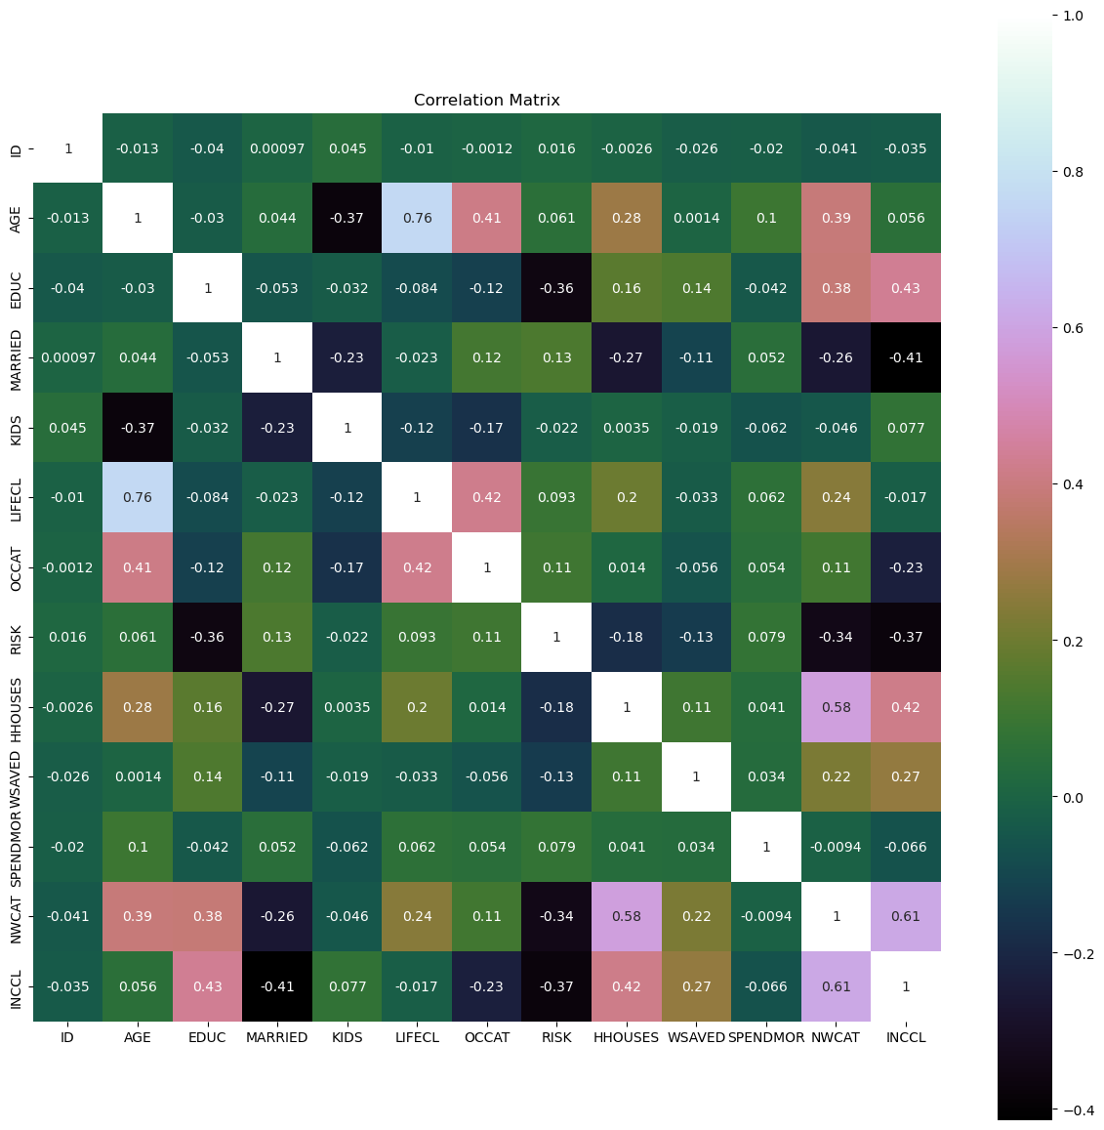

Slide 18
4. Data Preparation

Slide 19
4.1. Data Cleaning
Let us check for the NAs in the rows, either drop them or fill them with the mean of the column.

Slide 20
4.1. Data Cleaning
# Checking for any null values and removing the null values
print('Null Values =',dataset.isnull().values.any())
Sample output:
Null Values = False

Slide 21
4.1. Data Cleaning
Given there isn't any missing data and the data is already in the categorical format no further data cleaning was performed. The ID column which is not needed is dropped.

Slide 22
4.1. Data Cleaning
X=dataset.copy("deep")
X=X.drop(['ID'], axis=1)
pretty_print_df(X.head())
Sample output:
+----+-------+--------+-----------+--------+----------+---------+--------+-----------+----------+------------+---------+---------+
| | AGE | EDUC | MARRIED | KIDS | LIFECL | OCCAT | RISK | HHOUSES | WSAVED | SPENDMOR | NWCAT | INCCL |
|----+-------+--------+-----------+--------+----------+---------+--------+-----------+----------+------------+---------+---------|
| 0 | 3.000 | 2.000 | 1.000 | 0.000 | 2.000 | 1.000 | 3.000 | 1.000 | 1.000 | 5.000 | 3.000 | 4.000 |
| 1 | 4.000 | 4.000 | 1.000 | 2.000 | 5.000 | 2.000 | 3.000 | 0.000 | 2.000 | 5.000 | 5.000 | 5.000 |
| 2 | 3.000 | 1.000 | 1.000 | 2.000 | 3.000 | 2.000 | 2.000 | 1.000 | 2.000 | 4.000 | 4.000 | 4.000 |
| 3 | 3.000 | 1.000 | 1.000 | 2.000 | 3.000 | 2.000 | 2.000 | 1.000 | 2.000 | 4.000 | 3.000 | 4.000 |
| 4 | 4.000 | 3.000 | 1.000 | 1.000 | 5.000 | 1.000 | 2.000 | 1.000 | 3.000 | 3.000 | 5.000 | 5.000 |
+----+-------+--------+-----------+--------+----------+---------+--------+-----------+----------+------------+---------+---------+

Slide 23
4.2. Data Transformation
The data available is comprised of attributes with similar scale. Hence no data transformation is required.

Slide 24
5. Evaluate Algorithms and Models

Slide 25
5.1. K-Means Clustering
5.1.1. Finding optimal number of clusters
In this step we look at the following metrices to get the optimum number of clusters. Typically, two metrics are used to evaluate the number of clusters in K-means model.
1. Sum of square errors (SSE) within clusters
2. Silhouette score.

Slide 26
5.1.1. Finding optimal number of clusters
distorsions = []
max_loop=40
for k in range(2, max_loop):
k_means = KMeans(n_clusters=k, random_state=10, n_init=10)
k_means.fit(X)
distorsions.append(k_means.inertia_)
fig = plt.figure(figsize=(10, 5))
plt.plot(range(2, max_loop), distorsions)
plt.xticks([i for i in range(2, max_loop)], rotation=75)
plt.xlabel("Number of clusters")
plt.ylabel("Sum of Square Error")
plt.grid(True)
plt.show()

Slide 27
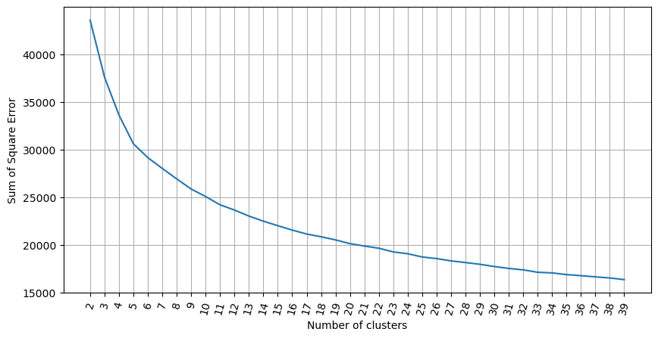

Slide 28
5.1.1. Finding optimal number of clusters
from sklearn import metrics
silhouette_score = []
for k in range(2, max_loop):
kmeans = KMeans(n_clusters=k, random_state=10, n_init=10)
kmeans.fit(X)
silhouette_score.append(
metrics.silhouette_score(X, kmeans.labels_, random_state=10)
)
fig = plt.figure(figsize=(10, 5))
plt.plot(range(2, max_loop), silhouette_score)
plt.xticks([i for i in range(2, max_loop)], rotation=75)
plt.xlabel("Number of clusters")
plt.ylabel("Silhouette score")
plt.grid(True)
plt.show()

Slide 29
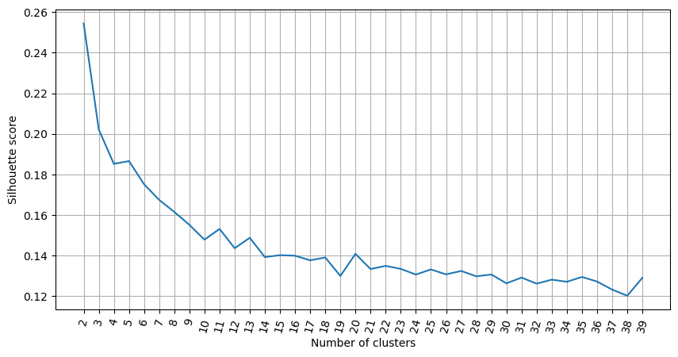

Slide 30
5.1.1. Finding optimal number of clusters
Looking at both the charts above, the optimum number of clusters seem to be around 7. We can see that as the number of clusters increase pass 6, the sum of square of errors within clusters plateaus off. From the second graph, we can see that there are various parts of the graph where a kink can be seen. Since there is not much a difference in SSE after 7 clusters, we would use 7 clusters in the k-means model below.

Slide 31
5.1.2. Clustering and Visualisation
Let us build the k-means model with 7 clusters and visualize the results.
nclust=7
# Fit with k-means
k_means = cluster.KMeans(n_clusters=nclust, random_state=10, n_init=10)
k_means.fit(X)
# Extracting labels
target_labels = k_means.predict(X)

Slide 32
5.2. Affinity Propagation Clustering
ap = AffinityPropagation(
damping = 0.5, max_iter = 250, affinity = 'euclidean', random_state=10,
)
ap.fit(X)
clust_labels2 = ap.predict(X)
cluster_centers_indices = ap.cluster_centers_indices_
labels = ap.labels_
n_clusters_ = len(cluster_centers_indices)
print('Estimated number of clusters: %d' % n_clusters_)
Sample output:
Estimated number of clusters: 161

Slide 33
5.3. Cluster Evaluation
We evaluate the clusters using Silhouette Coefficient (sklearn.metrics.silhouette_score). Higher Silhouette Coefficient score means a model with better defined clusters.

Slide 34
5.3. Cluster Evaluation
from sklearn import metrics
print("km", metrics.silhouette_score(X, k_means.labels_, metric='euclidean'))
print("ap", metrics.silhouette_score(X, ap.labels_, metric='euclidean'))
Sample output:
k-means has much higher Silhouette Coefficient as compared to the affinity propagation.
km 0.16746166685459618
ap 0.09795493325578218

Slide 35
6. Cluster Intuition

Slide 36
6. Cluster Intuition
In the next step, we will check each cluster and understand the intuition behind the clusters.

Slide 37
6. Cluster Intuition
cluster_output = pd.concat(
[pd.DataFrame(X), pd.DataFrame(k_means.labels_, columns = ['cluster'])],
axis = 1
)
output = cluster_output.groupby('cluster').mean()
pretty_print_df(output)
Sample output:
+-----------+-------+--------+-----------+--------+----------+---------+--------+-----------+----------+------------+---------+---------+
| cluster | AGE | EDUC | MARRIED | KIDS | LIFECL | OCCAT | RISK | HHOUSES | WSAVED | SPENDMOR | NWCAT | INCCL |
|-----------+-------+--------+-----------+--------+----------+---------+--------+-----------+----------+------------+---------+---------|
| 0 | 4.675 | 3.465 | 1.226 | 0.305 | 5.356 | 2.083 | 2.748 | 0.943 | 2.630 | 3.584 | 4.522 | 4.510 |
| 1 | 1.881 | 2.389 | 1.337 | 2.173 | 3.358 | 1.451 | 3.412 | 0.490 | 2.222 | 4.527 | 1.671 | 3.070 |
| 2 | 1.847 | 2.328 | 1.320 | 2.030 | 3.328 | 1.457 | 3.301 | 0.465 | 2.191 | 2.043 | 1.626 | 3.062 |
| 3 | 4.826 | 2.158 | 1.574 | 0.191 | 5.613 | 2.359 | 3.544 | 0.711 | 2.267 | 3.870 | 2.367 | 2.686 |
| 4 | 2.510 | 3.540 | 1.116 | 1.758 | 2.909 | 1.419 | 2.579 | 0.909 | 2.579 | 1.909 | 4.157 | 4.680 |
| 5 | 2.451 | 3.457 | 1.161 | 1.401 | 2.686 | 1.408 | 2.545 | 0.951 | 2.717 | 4.398 | 3.993 | 4.615 |
| 6 | 1.918 | 2.877 | 1.630 | 0.002 | 1.372 | 1.535 | 3.167 | 0.429 | 2.404 | 3.540 | 1.854 | 3.036 |
+-----------+-------+--------+-----------+--------+----------+---------+--------+-----------+----------+------------+---------+---------+

Slide 38
6. Cluster Intuition
# ### Demographics Features
output[['AGE','EDUC','MARRIED','KIDS','LIFECL','OCCAT']].plot.bar(
rot=0, figsize=(18,5)

Slide 39
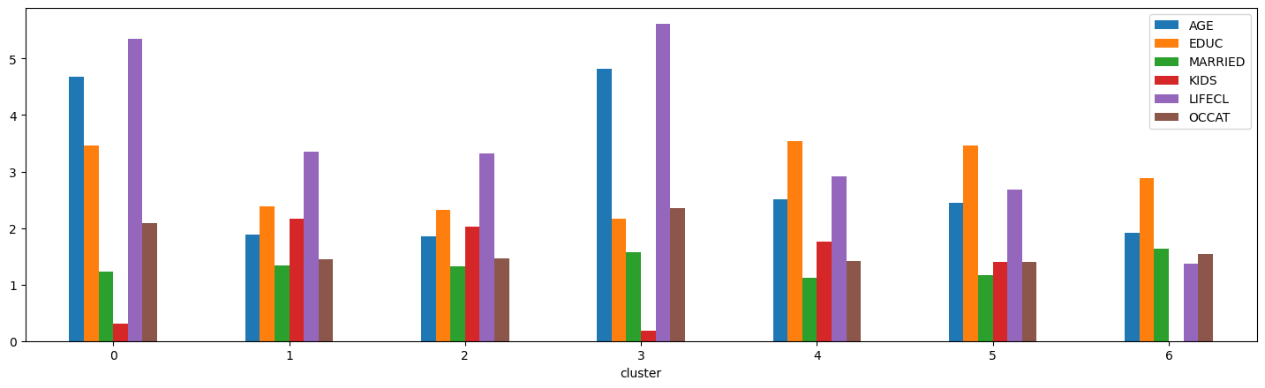
The plot here shows the average value of the attributes for each of the clusters. For example, comparing cluster 5 and cluster 3, cluster 5 has lower average age, yet higher average education. In terms of marriage, these two clusters are similar. So, the individuals in cluster 5 will on an average have higher risk tolerance as compared to the individuals in cluster 3, based on the demographic attributes.

Slide 40
6. Cluster Intuition
# ### Financial Features and Features related to willingness to take risk
output[['HHOUSES','NWCAT','INCCL','WSAVED','SPENDMOR','RISK']].plot.bar(
rot=0, figsize=(18,5)
)
plt.show()

Slide 41
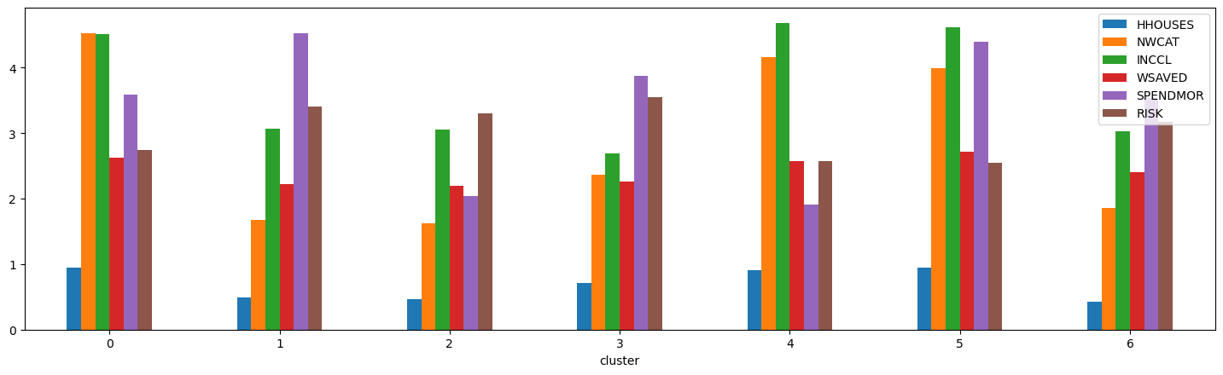
The plot here shows the average value of the attributes for each of the cluster on the financial and behavioral attributes. For example, comparing cluster 5 and cluster 3, cluster 5 has higher average house ownership, higher average net worth and income, and a higher willingness to take risk. In terms of saving vs. income comparison and willingness to save, the two clusters are comparable. Therefore, we can posit that the individuals in cluster 5 will, on average, have a higher ability, higher willingness, to take risk compared with cluster 3.

Slide 42
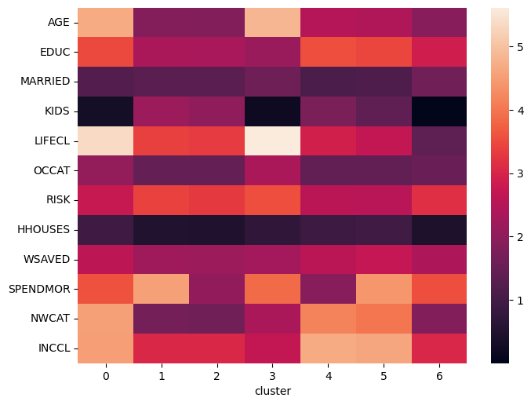
6. Cluster Intuition
sns.heatmap(output.T)
plt.show()

Slide 43
6. Cluster Intuition
Combining the information from the demographics, financial, and behavioral attributes for cluster 5 and cluster 3, the overall ability to take risk for individual cluster 5 is higher as compared to cluster 3. Performing similar analysis across all other clusters, we summarize the results in the table below. The risk tolerance column represents the subjective assessment of the risk tolerance of each of the clusters.

Slide 44
6. Cluster Intuition
Cluster | Features | Risk Capacity
Cluster 0 | High age, high net worth and Income, highly risky life category, willingness to take risk, own house | Medium
Cluster 1 | Low age, low income and net worth, high willingness to take risk, many kids | Low
Cluster 2 | Low age, low income and net worth, high willingness to take risk, many kids, own house | Low
Cluster 3 | High age, low net worth and Income, highly risky life category, willingness to take risk, low education | Low
Cluster 4 | Medium age, high income and net worth, willingness to take risk, many kids, own house | High
Cluster 5 | Low age, high networth and income, Less risky life category, willingness to spend more | High
Cluster 6 | Low age, low income and net worth, high willingness to take risk, no kids | Medium

Slide 45
Conclusion
One of the key takeaways from this case study is the approach to understand the cluster intuition. We used visualization techniques to understand the expected behavior of a cluster member by qualitatively interpreting mean values of the variables in each cluster.
We demonstrate the efficiency of the clustering technique in discovering the natural intuitive groups of different investors based on their risk tolerance.

Slide 46
Conclusion
Given, the clustering algorithms can successfully group investors based on different factors, such as age, income, and risk tolerance, it can further used by portfolio managers to understand the investor’s behavior and standardize the portfolio allocation and rebalancing across the clusters, making the investment management process faster and effective.

